Slide 1
HASHING

Slide 2
Introduction
To search a record, some comparisons have to be be made
Ideal search technique
  O(1)

Slide 3
Introduction
For O(1), the location of the record depends on the key
The most efficient way to organize such a table is an array.
  If the record keys are integers, the keys themselves can serve as indices to the array

Slide 4
Example
Suppose a manufacturing company has inventory file consisting of 100 parts, each part having a unique 2-digit part#. Then we can store this file in an array
  parttype part[100]
Here the part# is serving as key.

Slide 5
Limitations
Suppose that the company has an inventory file of few hundred parts,
  each part having a 7 digit unique part#
To use direct indexing as in previous example, an array of 10 million would be required.
  This is too much wastage of memory

Slide 6
example
Company has fewer than 1000 parts
Each record is keyed with a 7 digit part#
An array of 1000 elements will serve our purpose
  Index range is 0-999
The last three digits of the part# can be used as the index

Slide 7
Hash function
A function that transforms a key into an index is called a hash function.
If h is a hash function and key is a key, then h(key) is called the hash of key
This h(key) is the index at which the record with key key should be placed
The hash function in this example is
  h(key) = key % 1000

Slide 8
Problem
The foregoing method has one flaw.
Suppose that two keys k1 and k2 are such that h(k1) equals h(k2).
Two records cant occupy the same position
Such a situation is called hash collision or a hash clash

Slide 9
Collision Resolution
Collision can be resolved by
  linear probing
  quadratic probing
  Chaining

Slide 10
Good hash function
A good hash function is one that minimizes collisions and spreads the records uniformly throughout the table
Large array size is desirable
It is time/space tradeoff

Slide 11
Linear Probing
Consider the following hash functions
  h(key) = key % 1000
What happens, if we try to insert two records with keys 0596397 and 4957397
The simplest method of resolving hash clashes is to place the record in the next available position in the array

Slide 12
Rehash function
If array location h(key) is already occupied, then we apply rehash functions as rh(h(key)), if this too is occupied, then we apply again the same rehash functions as rh(rh(h(key)))

Slide 13
int arraysize = 100;
struct Student{
int rollno;
string name;
float cgpa;
int phone;
};
Student array[100];
void insert(Student s)
{
int index = s.rollno%100;
while(array[index].rollno!=0)
index=(index+1)%100; //linear probing
array[index]=s;
}
int main()
{
for(int i=0;i<100;i++)
array[i].rollno = 0;
for(;;){
Student temp;
cout<<"Enter a student record";
cin>>temp.rollno>>temp.name >>temp.cgpa>>temp.phone;
insert(temp);
}
}

Slide 14
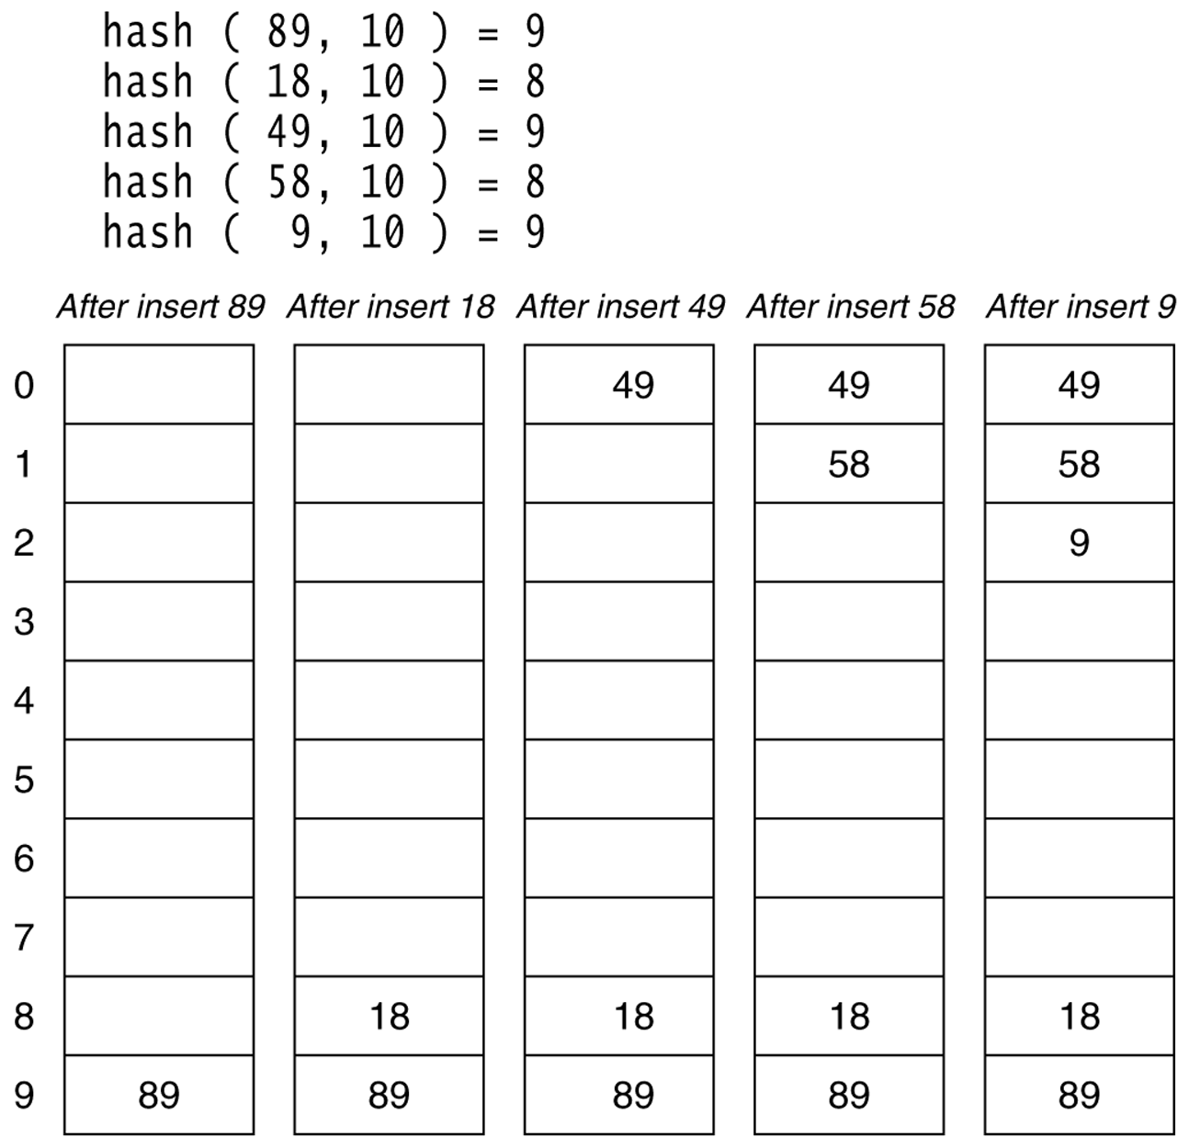
Linear Probing

Slide 15
Linear Probing
Inserting 89, 18, 49, 58, 69
With h(key) = key % 10
rh(i) = (i+1)%10, where i=h(key), rh(h(key)), rh(rh(h(key)))
89 – successfully inserted
18 – successfully inserted
49 – hash clash
rh(9) = (9+1)%10 = 0
58 – hash clash
rh(8) = (8+1)%10 = 9
rh(9) = (9+1)%10 = 0
rh(0) = (0+1)%10 = 1
69 – hash clash
rh(9) = (9+1)%10 = 0
rh(0) = (0+1)%10 = 1
rh(1) = (1+1)%10 = 2

Slide 16
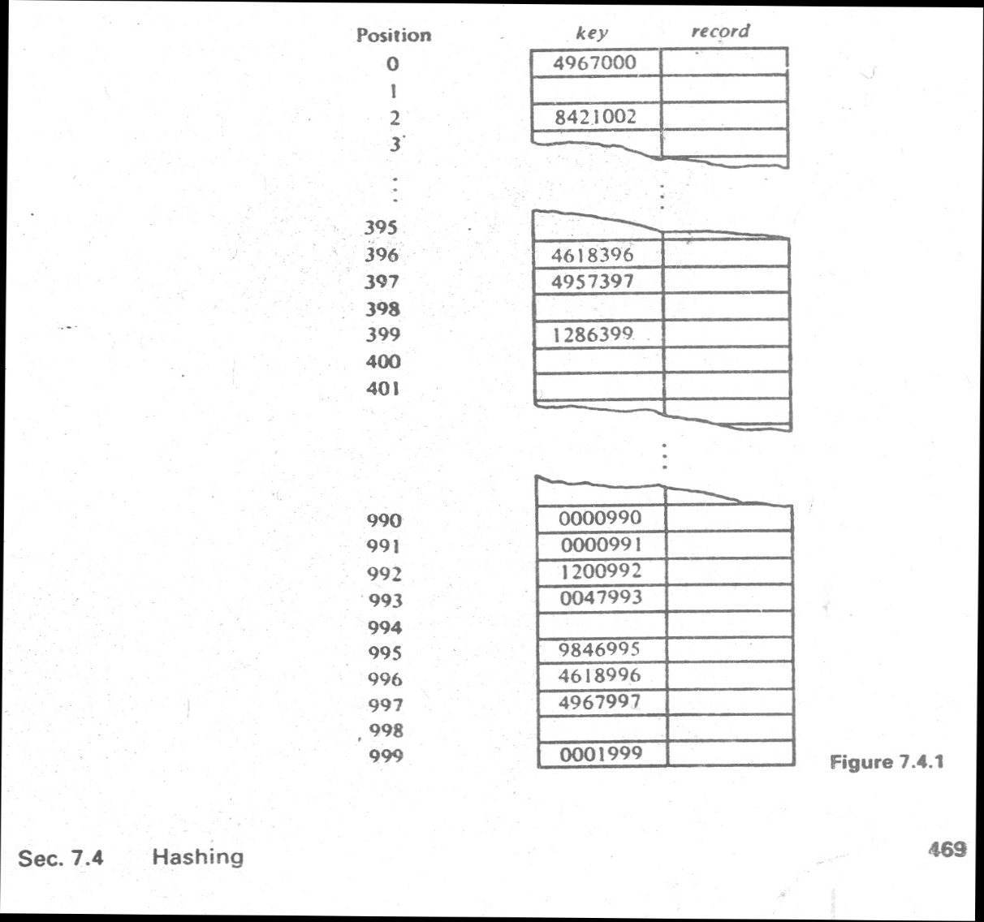
Clustering

Slide 17
Quadratic Probing
Collision resolution method
Eliminates primary clustering
Popular quadratic function is i²

Slide 18
int arraysize = 100;
struct Student{
int rollno;
string name;
float cgpa;
int phone;
};
Student array[100];
void insertQ(Student s)
{
int index = s.rollno%100;
for(int i=1; array[index].rollno!=0;i++)
index = ((s.rollno%100)+(i*i))%100; //Quadratic probing
array[index]=s;
}
int main()
{
for(int i=0;i<100;i++)
array[i].rollno = 0;
for(;;){
Student temp;
cout<<"Enter a student record";
cin>>temp.rollno>>temp.name >>temp.cgpa>>temp.phone;
insertQ(temp);
}
}

Slide 19
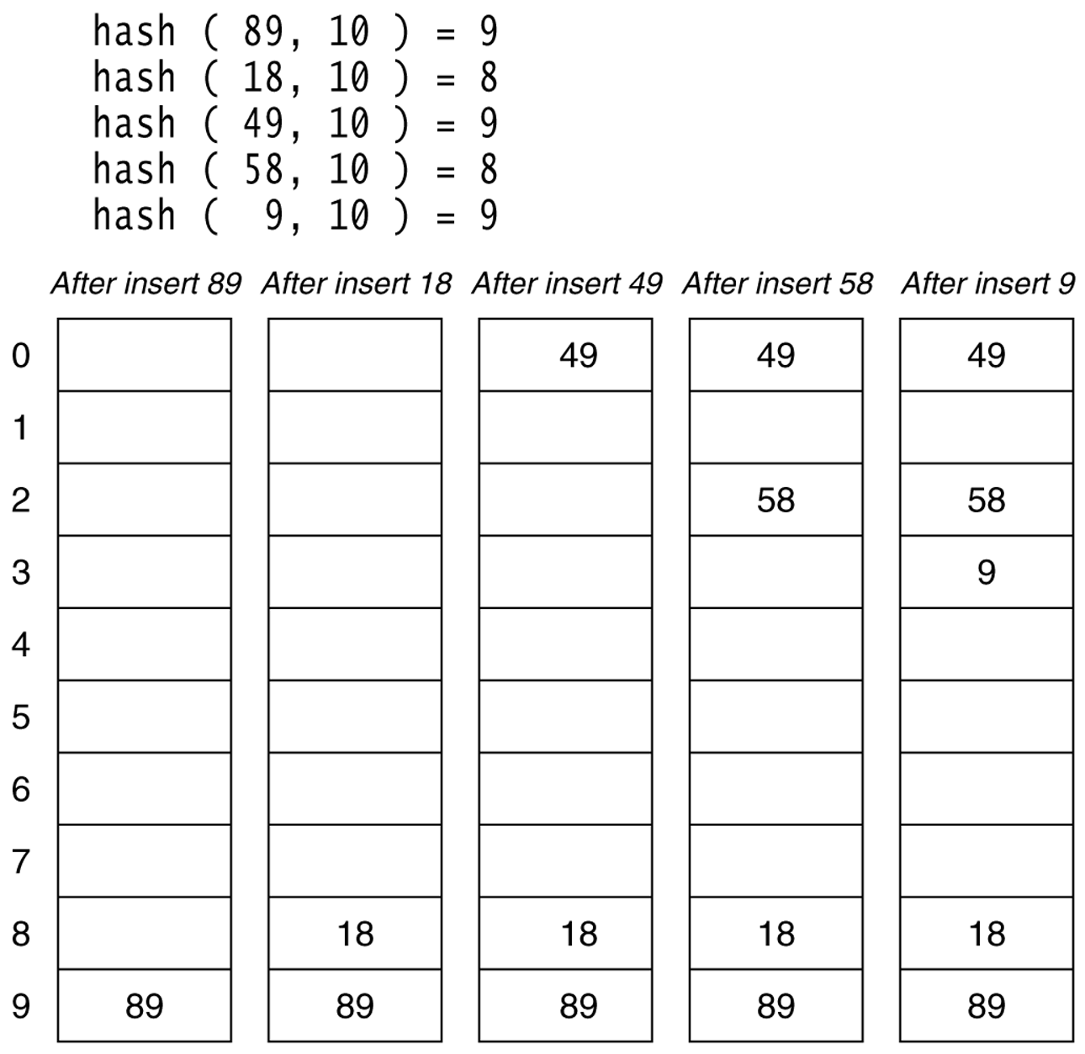
Quadratic Probing

Slide 20
Quadratic Probing
Inserting 89, 18, 49, 58, 69
With h(key) = key % 10
rh(h(key)) = (h(key)+k²)% 10, where k = 1,2,3, ….
89 – successfully inserted
18 – successfully inserted
49 – hash clash
i=1, rh(9)= (9+1²)%10 = 0
58 – hash clash
i=1, rh(8) = (8+1²)%10 = 9
i=2, rh(8) = (8+2²)%10 = 2
9 – hash clash
i=1, rh(9) = (9+1²)%10 = 0
i=2, rh(9) = (9+2²)%10 = 3

Slide 21
Analysis
Worst case for inserting a key is O(n)
Worst case for searching is O(n)

Slide 22
Chaining
In chaining, array of pointers is used
Each pointer acts as a head pointer, and there can be as many link lists as there are pointers
The index i returned by the hash function, will be used to put the data into the link list pointed by Array[i]
If there is no collision, no link list will have more then one node

Slide 23
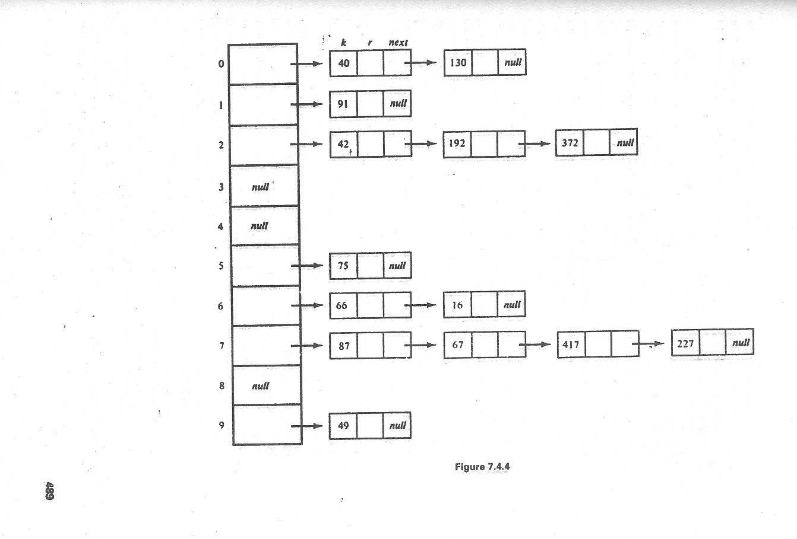
Chaining
Put all the elements that hash to same slot in a linked list.

Slide 24
Analysis of Chaining
Worst case : All n keys hash to the same slot resulting in a linked list of length n, running time: O(n)
Assume simple uniform hashing: each key in table is equally likely to be hashed to any slot
Load Factor (α ):
  It is defined as average # keys per non empty slot
  Given n keys and m non empty slots in the table: the load factor α = n/m = average # keys per non empty slot

Slide 25
Analysis of Chaining
Insertion
  Insert at head of list,
  O(1)
Searching
  O(α )

Slide 26
Nature of keys
Keys can be numeric or character type
A character key can be interpreted as an integer expressed in suitable notation.

Slide 27
Nature of keys
Example: The string “pt” might be interpreted as a pair of decimal integers (112, 116) as p = 112 and t = 116 in ASCII notation.
What is the problem?
Using a product/addition of ASCII codes is indifferent to the order of characters
  For example: pt = 112+116 = 128
  tp = 116+112 = 128
Solution: (112.128) + 116 = 14,452

Slide 28
Methods to create hash functions
Division method
Multiplication method

Slide 29
Division method
The division method requires two steps.
  The key must be transformed into an integer.
  The value must be telescoped into range 0 to m-1

Slide 30
Division method…
We map a key k into one of the m slots by taking the remainder of k divided by m, so the hash function is of form
h(k)= k mod m
For example , if m=12, key is 100 then h(k)=100 mod 12= 4.

Slide 31
Restrictions on value of m
M should not be a power of 2, since if m=2^{p} then h(k) is just the p lowest order bits of k.
Disadvantage!
Key | Binary | K mod 8
8 | 1000 | 0
7 | 111 | 7
12 | 1100 | 4
34 | 100010 | 2
56 | 111000 | 0
78 | 1001110 | 6
90 | 1011010 | 2
23 | 10111 | 7
45 | 101101 | 5
67 | 1000011 | 3

Slide 32
Restrictions on value of m
it is better to make the hash function dependent on all the bits of the key.

Slide 33
Good value of m
Power of 10 should be avoided, if application deals with decimal numbers as keys.
Good values of m are primes not close to the exact powers of 2 (or 10).

Slide 34
Example
Construct a hash table with collision resolved by chaining
  n = 2000 character strings
  We don’t mind examining an average of 3 elements in an unsuccessful search
  What value of m should be chosen?
  m should be prime, not near to any power of 2 or 10
  m = 701

Slide 35
Multiplication method
Using a random real number f in the range [0,1).
The fractional part of the product f*key yields a number in the range 0 to 1.
When this number is multiplied by m (hash table size), the integer portion of the product gives the hash value in the range 0 to m-1

